Slide 1
Working with Kubernetes
Srinivasan S Iyer

Slide 2

Kubernetes
A container (microservices) orchestration system
A cluster management system for running distributed applications

Slide 3
What Does Kubernetes provide
Provisioning and deploying containers on multiple container hosts (nodes) Service discovery and load balancing network traffic
Automatically scaling container instances up and down
Automated rollouts and rollbacks of new container image versions
Automatic, optimal bin-packing of containers with regard to resources such as CPU or memory
Application monitoring, telemetry gathering, and health checks
Orchestrating and abstracting storage (local, on-premises, or the cloud)

Slide 4
High-level Architecture
CRI = Container Runtime Interface CRI

Slide 5
High-level Architecture - Cloud

Slide 6
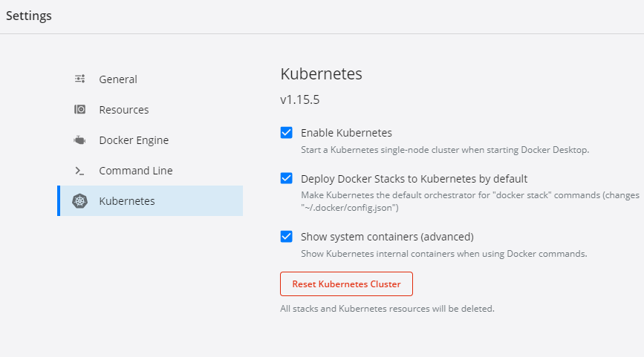
Getting Started with Kubenetes
Install Docker on Windows
Enable Kubernetes
Open Command Prompt >
>Kubectl version

Slide 7
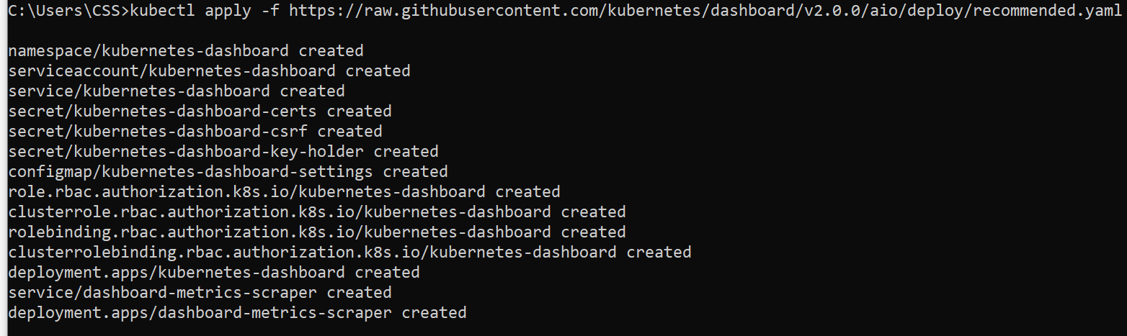
Configuring Kubenetes Dashboard
The Dashboard UI is not deployed by default. To deploy it, run the following command:
kubectl apply -f https://raw.githubusercontent.com/kubernetes/dashboard/v2.0.0/aio/deploy/recommended.yaml

Slide 8
Creating the User-token
Step 1 :Create the token for user and save to config file
PS C:\Users\CSS> $TOKEN=((kubectl -n kube-system describe secret default | Select-String "token:") -split " +")[1]
PS C:\Users\CSS> kubectl config set-credentials docker-for-desktop --token="${TOKEN}"
User "docker-for-desktop" set.
PS C:\Users\CSS>
Step 1 – Opt Create the token and printing onto console
kubectl -n kubernetes-dashboard describe secret $(kubectl -n kubernetes-dashboard get secret | sls admin-user | ForEach-Object { $_ -Split '\s+' } | Select -First 1)

Slide 9
Accessing the Dashboard
Step 2 : In a separate command prompt start the proxy
C:\Users\CSS>kubectl proxy
Starting to serve on 127.0.0.1:8001
Step 3: Navigate to Dashboard url on the browser
Dashboard Url:
http://localhost:8001/api/v1/namespaces/kubernetes-dashboard/services/https:kubernetes-dashboard:/proxy/.

Slide 10
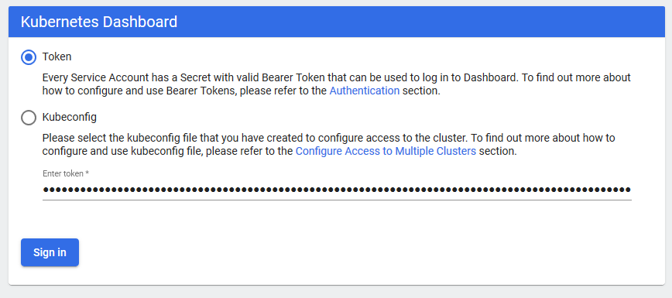
Accessing the Dashboard
Step 4 : Provide Token in the Dashboard UI

Slide 11
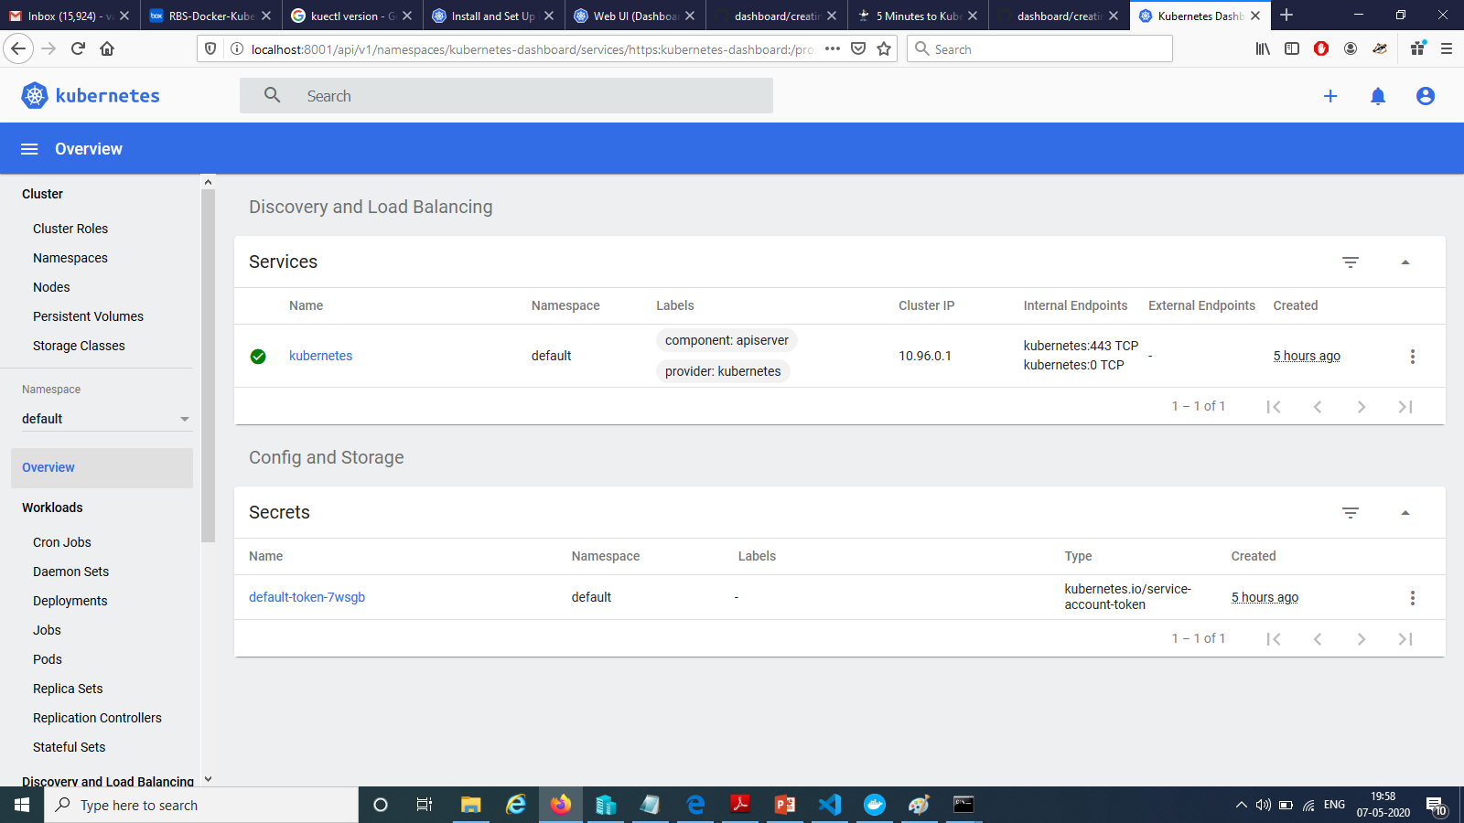
Accessing the Dashboard

Slide 12
Kubernetes Objects
In the Kubernetes cluster, the cluster state is managed by the kube-apiserver component and is persisted in the etcd cluster.
The state is abstracted and modeled as a set of Kubernetes objects – these entities describe:
What containerized applications should be run?
How they should be scheduled?
What must be the policies concerning restarting or scaling them?
If there is anything you would like to achieve in your Kubernetes cluster, then you have to create or update Kubernetes objects.

Slide 13
Kubernetes Objects
Kubernetes provides for a declarative model for objects
You declare your intent and Kubernetes is responsible for changing the current state of the cluster to the desired (intended) one.
The declarative model and the idea of maintaining the desired state is what makes Kubernetes so powerful and easy to use.

Slide 14
Kubernetes Objects
All Kubernetes Objects have the same Object State philosophy :
Spec: This defines the desired state of the Object. This is where you define your requirements when creating or updating an Object.
Status: This is provided by Kubernetes and describes the current state of the Object.
Working with Kubernetes objects always requires using the Kubernetes API. Most commonly, you will manage Kubernetes objects using the command-line interface (CLI) for Kubernetes, which comes as a kubectl binary. It is also possible to interact with the Kubernetes API directly using client libraries.

Slide 15
Structuring Kubernetes Object
When interacting directly with the Kubernetes API, objects must be specified in JSON format.
However, kubectl allows us to use YAML manifest files, which are translated into JSON when you perform operations.
Using YAML manifest files is generally recommended

Slide 16
A Pod Definition in YAML -Manifest
apiVersion: The version of the Kubernetes API being used for this Object.
kind: The type of Kubernetes Object. In this case, this is Pod.
metadata: Additional metadata for the Object.
spec: The Object Spec. In the example specification, the nginx container uses
the nginx:1.17 Docker image and exposes port 80.
The Spec is different for every Kubernetes Object and has to follow the API documentation
apiVersion: v1
kind: Pod
metadata:
name: nginx-pod-example
labels:
app: nginx-host
spec:
containers:
- name: nginx
image: nginx:1.17
ports:
- containerPort: 80

Slide 17
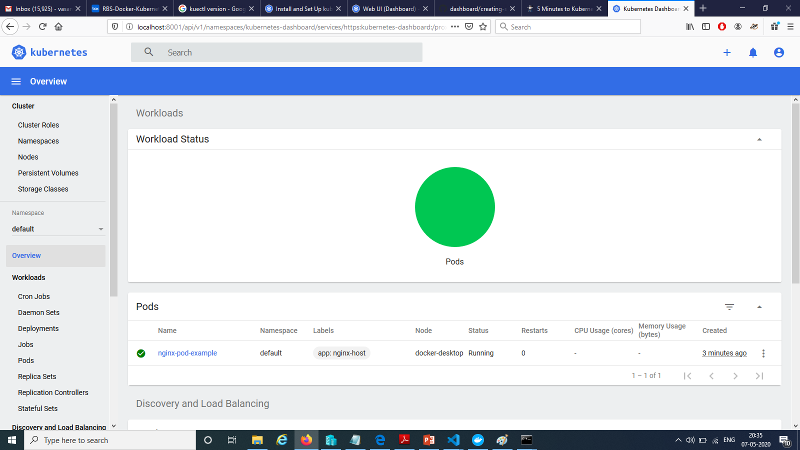
Deploying the Manifest
> kubectl apply -f .\01-FirstPod.yaml
pod/nginx-pod-example created
>kubectl get pods
NAME READY STATUS RESTARTS AGE
nginx-pod-example 1/1 Running 0 119s

Slide 18
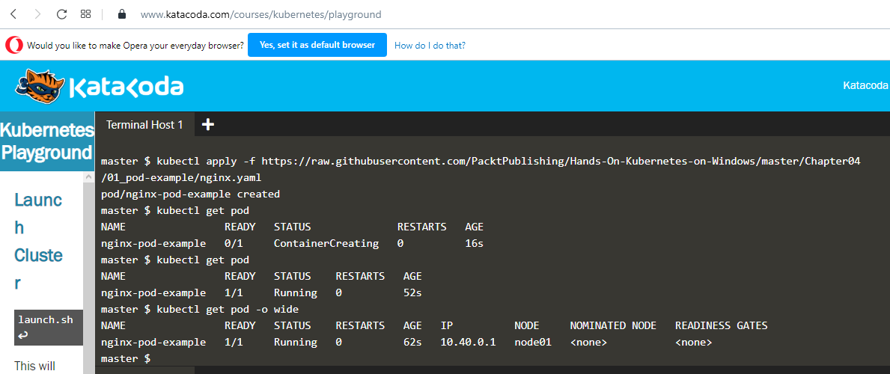
Deploying the Manifest – Katacoda Playground
kubectl apply -f https://raw.githubusercontent.com/PacktPublishing/Hands-On-Kubernetes-on-Windows/master/Chapter04/01_pod-example/nginx.yaml

Slide 19
About Pods
Kubernetes uses Pods as its basic, atomic unit for Deployment and scaling, and represents processes running in the cluster – an analogy from Microsoft Hyper-V would be a single virtual machine that you deploy as an atomic unit in your Hyper-V cluster.
A Kubernetes Pod consists of one or more containers that share kernel namespaces, IPC, storage and network stack (you address them by the same cluster IP and they can communicate via localhost)

Slide 20
Multi Container Pods
For some scenarios, you may need multiple-container Pods, where the main container is accompanied by additional containers that serve multiple purposes:
Sidecar containers, which can perform various helper operations, such as log collection, data synchronization for the main container, and so on.
Adapter containers, which can normalize output or monitor the data of the main container so that it can be used by other services.
Ambassador containers, which proxy the communication of the main container with the outside world.
Init containers, which are specialized containers that run before application containers in the Pod. For example, they may set up the environment, which isn't performed in the main container image

Slide 21
Multi Container Pods
Technically, even single-container Pods contain an extra infra container, which is often a pause image. It acts as a parent container for all containers in the pod and enables kernel namespaces sharing.
Delegate Cross-cuts to Support Containers in a Pod

Slide 22
Pod Considerations
Pod's containers always run on one node and once a Pod is created, it is always bound to one node.
You scale your application by adding more Pods, not by adding more containers inside the same Pod.
A Pod is considered ready and able to serve requests when all its containers are ready. The status of a container is determined by Probes, for example, liveness and readiness Probes, which can be defined in the Spec.
Pods are ephemeral. They are created, they die, and new ones are recreated in their place (if needed).
When a Pod is recreated, it receives a new cluster IP. This means that your application design should never rely on static IP assignments and assume that the Pod may even be recreated on a different node.

Slide 23
Replicasets
Kubernetes builds many powerful concepts on top of Pods, which makes container management easy and predictable.
The simplest one is the ReplicaSet API Object (the successor of ReplicationController), which aims at maintaining a fixed number of healthy
Pods (replicas) to fulfill certain conditions. In other words, if you say I want three nginx Pods running in my cluster, ReplicaSet does that for you.
If a Pod is destroyed, ReplicaSet will automatically create a new Pod replica to restore the desired state.

Slide 24
Defining a Replicaset
apiVersion: apps/v1
kind: ReplicaSet
metadata:
name: nginx-replicaset-example
spec:
replicas: 3
selector:
matchLabels:
environment: test
template:
metadata:
labels:
environment: test
spec:
containers:
- name: nginx
image: nginx:1.17
ports:
- containerPort: 80
replicas: Defines the number of Pod replicas that should run using the given template and matching selector. Pods may be created or deleted in order to maintain the required number.
selector: A label selector, which defines how to identify Pods that the
ReplicaSet will acquire. Note that this may have a consequence of acquiring
existing bare Pods by ReplicaSet!
template: Defines the template for Pod creation. Labels used in metadata must
positively match the selector.

Slide 25
Replicaset vs Single Bare Pod

Slide 26
Replicaset vs Single Bare Pod Best Practice
When a single pod is created it is created as a bare Pods which are tied to the original only
Even if you need to create a single Pod in Kubernetes cluster, it is a much better idea to use a ReplicaSet with the replicas field set to 1(one), which will act as a container supervisor.
.

Slide 27
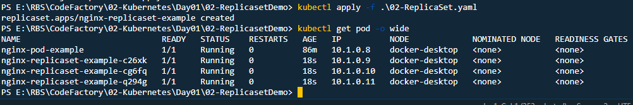
Creating the Replicaset

Slide 28
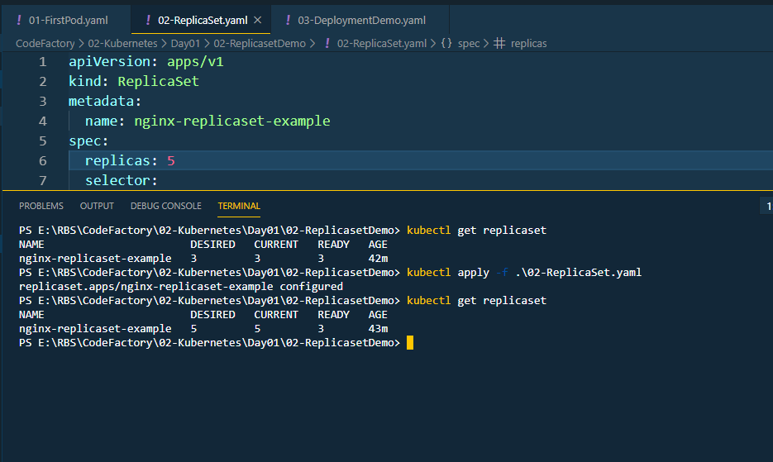
Updating the Replicaset

Slide 29
Deployments
Deployments are Kubernetes objects that provide declarative updates for Pods and ReplicaSets.
You can declaratively perform operations such as the following by using them:
Perform a rollout of a new ReplicaSet.
Change the Pod template and perform a controlled rollout. The old ReplicaSet will be gradually scaled down, whereas the new ReplicaSet will scale up at the same rate.
Perform a rollback to an earlier version of the Deployment.
Scale the ReplicaSet up or down.

Slide 30
Deployments-ReplicaSets-Pods
**Caution : You may be tempted to manage ReplicaSets created by a Deployment on your own.
If you need to make any changes to the ReplicaSet, perform the
changes on the owning Deployment Object.

Slide 31
Deployments-ReplicaSets-Pods

Slide 32
Deployment Sample
apiVersion: apps/v1
kind: Deployment
metadata:
name: nginx-deployment-example
spec:
replicas: 3
selector:
matchLabels:
environment: test
template:
metadata:
labels:
environment: test
spec:
containers:
- name: nginx
image: nginx:1.17
ports:
- containerPort: 80

Slide 33
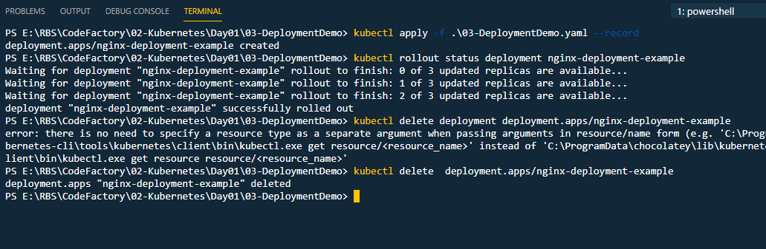
Deployment Sample – Life cycle

Slide 34
StatefulSets & Rationale
Deployments are usually used to deploy stateless components of your application.
For stateful components, Kubernetes provides another API Object called StatefulSet.
The principle of this operation is very similar to Deployment – it manages ReplicaSets and Pods in a declarative way and provides smooth rollouts and rollbacks.

Slide 35
StatefulSets vs Deployment
StatefulSets ensure a deterministic (sticky) ID of Pods, which consists of <statefulSetName>-<ordinal>.
For Deployments, you would have a random ID consisting of <deploymentName>-<randomHash>.
For StatefulSets, the Pods are started and terminated in a specific, predictable order while scaling the ReplicaSet.

Slide 36
DaemonSets
A DaemonSet is another controller-backed Object that is similar to a ReplicaSet but aims at running exactly one templated Pod replica per node in the cluster (optionally matching selectors).
Some common use cases for running a DaemonSet:
Managing monitoring telemetry for a given cluster node, for example, running Prometheus Node Exporter
Running a log collection daemon on each node, for example, fluentd or logstash
Running troubleshooting Pods, for example, node-problem-detector (https://github.com/ kubernetes/node-problem-detector)

Slide 37
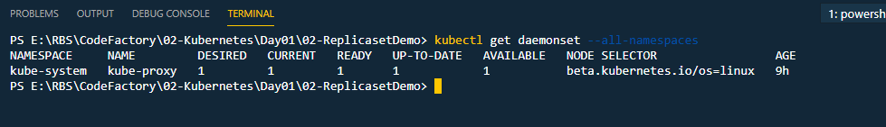
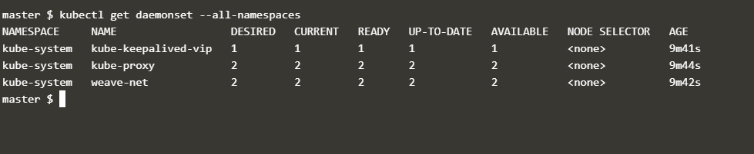
DaemonSets
Kube Proxy is an Out-of-the-Box DaemonSet
In a standard cluster deployment performed by kubeadm, kube-proxy is distributed to nodes as a DaemonSet
..Katacoda playgrond

Slide 38
Services
Pods that are created by ReplicaSets or Deployments have a finite life cycle.
Kubernetes manages the lifecycle, you can expect them to be terminated and new Pod replicas with new IP addresses will be created in their place.
So, what if you have a Deployment running web server Pods that need to communicate with Pods that have been created as a part of another Deployment, for example, backend Pods?
Web server Pods cannot assume anything about IP addresses
or the DNS names of backend Pods, as they may change over time. This issue is resolved with Service API objects, which provide reliable networking for a set of Pods.

Slide 39
Services
In general, Services target a set of Pods, and this is determined by label selectors.
The most common scenario is exposing a Service for an existing Deployment by using exactly the same label selector.
The Service is responsible for providing a reliable DNS name and IP address, as well as for monitoring selector results and updating the associated Endpoint Object with the current IP addresses of matching Pods.

Slide 40
Services
For internal clients (Pods in the cluster), the communication to Pods behind a service is transparent – they use the Cluster IP or DNS name of the Service and the traffic is routed to one of the destination Pods.
Routing capabilities are provided by kube-proxy, but it is
important to know that the traffic is not routed through any master components – kubeproxy implements routing at the operating system kernel level and directly routes this to an
appropriate Pod's IP address.

Slide 41
Services
In its simplest form, the destination Pod will be chosen
randomly, but with IP Virtual Server (IPVS) proxy mode, you can have more complex strategies, such as least connection or shortest expected delay.
Services can also expose Pods to external traffic.

Slide 42
Services – How does it work?

Slide 43
Services – A Sample – Katacoda Playground
kubectl apply -f https://raw.githubusercontent.com/PacktPublishing/Hands-On-Kubernetes-on-Windows/master/Chapter04/03_deployment-example/nginx-deployment.yaml --record
kubectl expose deployment nginx-deployment-example
kubectl run --generator=run-pod/v1 -i --tty busybox --image=busybox --rm --restart=Never -- sh
wget http://nginx-deployment-example && cat index.html

Slide 44
Storage in Kubernetes
In Docker, we have used volumes to provide persistence either on local disk or remote/cloud storage using volume plugins.
Docker volumes have a life cycle that's independent of the containers that consume them.
In Kubernetes, there is a similar concept of a Volume, which
is tightly coupled with a Pod and has the same life cycle as the Pod
Storage is a very complex, diverse and intense topic.
Refer to official documentation for support for devices, technologies etc :
https://kubernetes.io/docs/concepts/storage/

Slide 45
Storage in Kubernetes – Technology Choices
The most important aspect of Volumes in Kubernetes is that they support multiple backing storage providers (types) –– this is abstracted by Volume Plugins and, more recently, the Container Storage Interface (CSI)
CSI is an interface for out-of-tree Volume Plugins that are developed independently from Kubernetes core.
You can mount an Amazon Web Services EBS volume or Microsoft Azure Files SMB Share as a Volume for your Pod
For full list refer to documentation:
https://kubernetes.io/docs/concepts/storage/volumes/ #types-of-volumes

Slide 46
Storage-related Objects
One of the Volume types is PersistentVolumeClaim (PVC), which aims at decoupling Pods from the actual storage.
PersistentVolumeClaim is an API Object that models a request for the storage of a specific type, class, or size – I I would like 10 GB of read/writeonce SSD storage.
To fulfill such a request, a PersistentVolume (PV) API Object is required, which is a piece of storage that has been provisioned by the cluster's automation process.
will automatically create a PV using the selected provisioner.

Slide 47
Storage-related Objects
PersistentVolume types are also implemented as plugins, in a similar manner to Volumes.
Now, the whole process of provisioning PersistentVolumes can be dynamic – it requires creating a StorageClass (SC) API Object and using it when defining PVCs.
When creating a new StorageClass, you provide a provisioner (or plugin) with specific parameters, and each PVC using the given SC

Slide 48
Storage-related Architecture

Slide 49
Provisioning Storage - Workflow
1. Create a StorageClass with a desired provisioner.
2. Create a PersistentVolumeClaim that uses the SC.
3. PersistentVolume is dynamically provisioned.
4. When creating a Pod, mount the PVC as a Volume.

